Slide 1
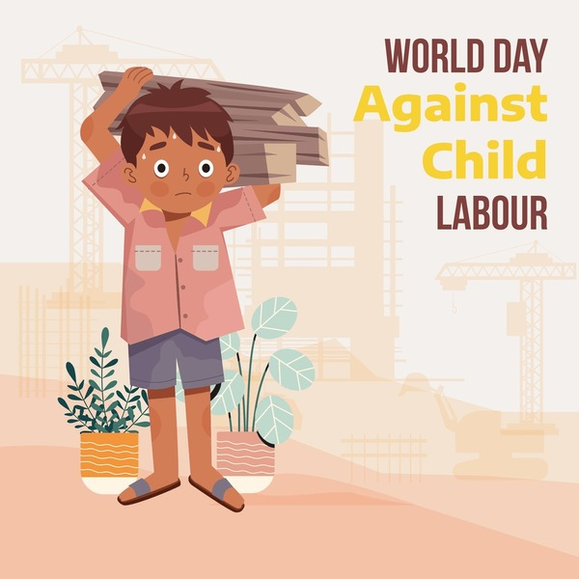
Child Labor
Understanding the Problem and Working Toward Solutions

Slide 2
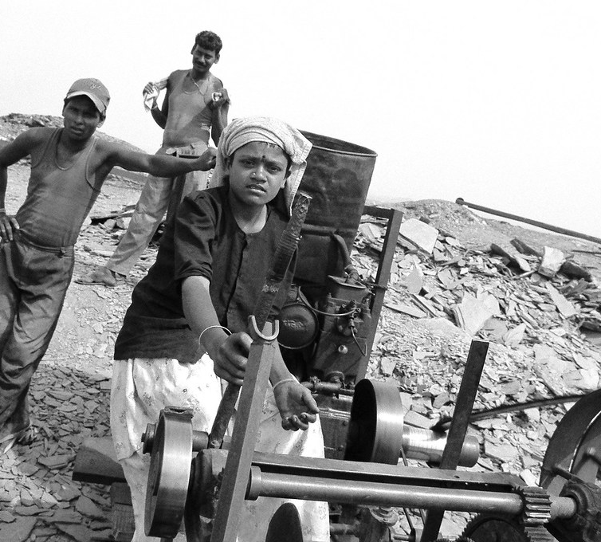
Introduction
What is child labor?
Brief definition: “Work that deprives children of their childhood, potential, and dignity.”
This Photo by Unknown Author is licensed under CC BY-ND

Slide 3
Causes of Child Labor
Poverty
Lack of access to education
Unemployment of parents
Cultural and social norms
Weak enforcement of laws

Slide 4
Types of Child Labor
Agriculture
Domestic work
Factory work
Mining
Street vending / begging

Slide 5
Consequences of Child Labor
Physical and mental health issues
Denial of education
Cycle of poverty continues
Abuse and exploitation

Slide 6
Global and Regional Statistics
Use charts or graphs
Show child labor prevalence by country or region
Mention ILO data

Slide 7
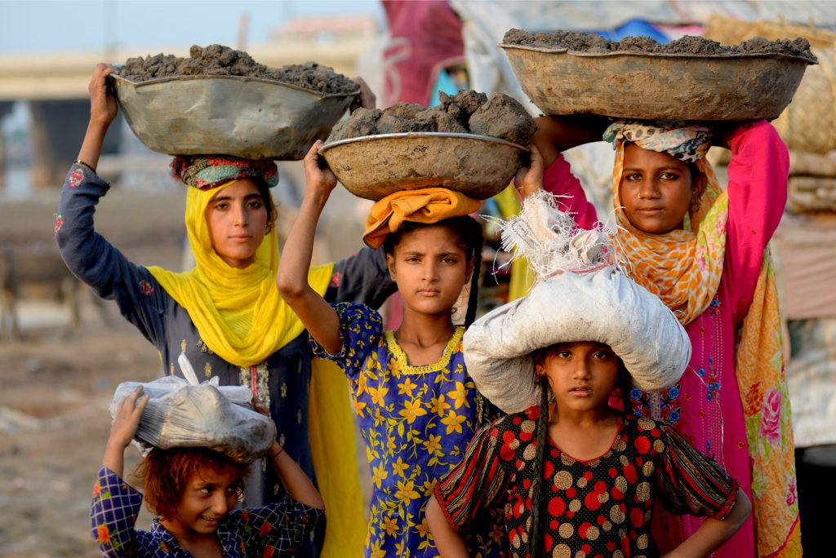
Laws and Regulations
International Labor Organization (ILO)
United Nations Convention on the Rights of the Child (UNCRC)
National laws (like Child Labor (Prohibition and Regulation) Act in India)

Slide 8

Real-Life Case Studies
Share 1–2 stories of rescued children
Highlight organizations that helped

Slide 9
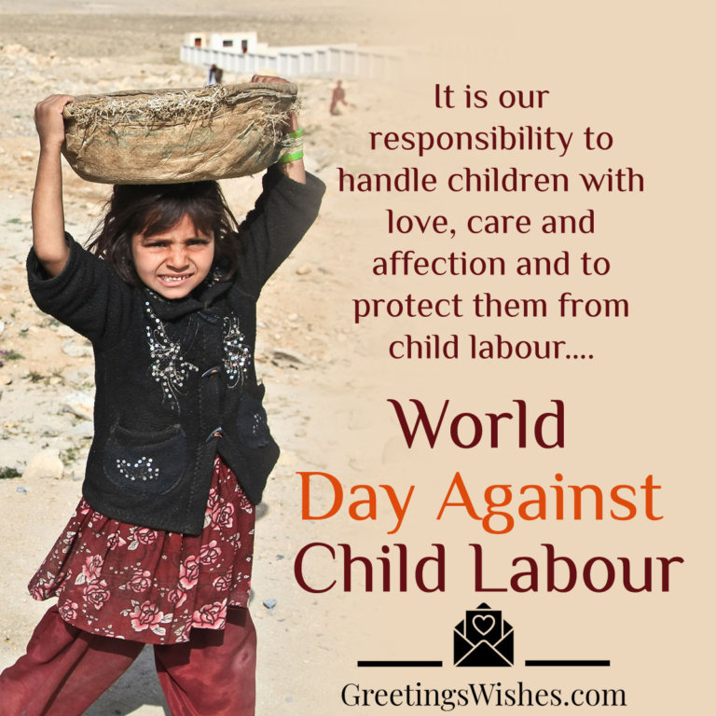

How We Can Help
Spreading awareness
Supporting NGOs
Encouraging education
Reporting violations

Slide 10
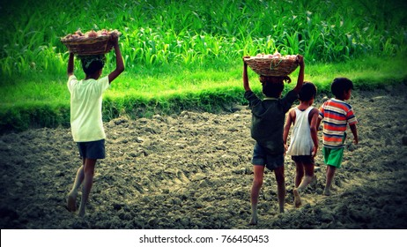
Conclusion
Recap key points
Emphasize that child labor is preventable
End with a powerful quote or call to action

